Slide 1
CS-0401
INTERMEDIATE PROGRAMMING USING JAVA
Prof. Dr. Paulo Brasko Ferreira
Spring 2018

Slide 2
Chapter 3 Decision Structures

Slide 3
Chapter 3 Presentation Outline
The if Statement
The if-else Statement
Nested if statements
The if-else-if Statement
Logical Operators
Comparing String Objects
The Conditional Operators
The Switch Operator
Displaying formatted output
.

Slide 4
The IF statement

Slide 5
The IF statement
Condition
(true or false)
I need to go to the lab!
If it’s cold outside, I’ll wear a coat
The “action” if the “condition” is true

Slide 6
The if Statement
The general form
if (condition is true)
execute next statement
What kind of statements can generate “true” or “false” values?

Slide 7
Boolean Expressions
A boolean expression is any variable or calculation that results in a true or false condition.
Expression | Meaning
x > y | Is x greater than y?
x < y | Is x less than y?
x >= y | Is x greater than or equal to y?
x <= y | Is x less than or equal to y.
x == y | Is x equal to y?
x != y | Is x not equal to y?

Slide 8
if Statements and Boolean Expressions
double x = 10, y = 5, z = 10;
if (x > y)
System.out.println("X is greater than Y");
if(x == z)
System.out.println("X is equal to Y");
if(x != y) {
System.out.println("X is not equal to Y");
x = y;
System.out.println("However, now it is.");
}
boolean isElegible = age > 16;
if (isElegible) {
takeDriverLicenseTest();
}

Slide 9
String Comparison
String name1 = “John”;
String name2 = “john”;
String name3 = “John”;
String name4 = “Mary”;
if(name1 == name3) // #1 true or false?
if(name1.equals(name3)) // #2 true or false?
if(name1.equals(name2)) // #3 true or false?
if(name1.equalsIgnoreCase(name2) // #4 true or false?
name1.compareTo(name4) // <, ==, or > 0 ?
name1.compareTo(name3) // <, ==, or > 0 ?
name1.compareTo(name2) // <, ==, or > 0 ?
name2.compareTo(name4) // <, ==, or > 0 ?
How last statement could be changed if case sensitive is not an issue?

Slide 10
String is an Object, not a primitive variable!
The right and wrong way of comparing objects, such as a String

Slide 11
A reference to where the elephant object is placed in the memory Elephant@0x12EF05
long

Slide 12
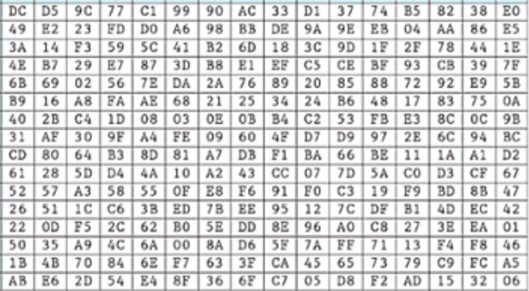
Comparing References instead of Values
String name1 = “John”;
String@87
J
o
h
n
name1
J
o
h
n
String name3 = “John”;
String@A9
if(name1 == name3)
if(x87 == xA9)
if(name1.equals(name2)
“John” is equal to “John”
name2

Slide 13
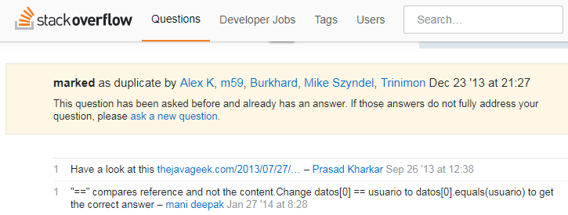
This was true for Strings until recently…

Slide 14
Flowcharts
IF statements can be modeled as a flow chart.
Get Ready
getReady();
if (coldOutside)
wearCoat();
takeTheBus();
Is it cold
outside?
Yes
Wear a coat
No
Take the bus

Slide 15
Flowcharts
If you have multiple tasks to perform if the condition is true, then use a block!
if (coldOutside) {
wearCoat();
wearHat();
wearGloves();
}
Is it cold
outside?
Yes
Wear a coat.
Note the use of curly
braces to block several
statements together as one
Wear a hat.
Wear gloves.

Slide 16
The IF-ELSE statement

Slide 17
if-else Statements
The if-else statement adds the ability to conditionally execute code when the if condition is false.
if (expression)
statementOrBlockIfTrue;
else
statementOrBlockIfFalse;

Slide 18
if-else Statement Flowcharts
No
Yes
Is it cold
outside?
Wear shorts
Wear a coat
Take the bus

Slide 19
Nested IF statements

Slide 20
Nested if Statement Flowcharts
No
Yes
Is it cold
outside?
Wear shorts
No
Is it
snowing?
Yes
Wear a jacket
Wear a parka

Slide 21
Nested if Statements
if (coldOutside) {
if (snowing) {
wearParka();
} else {
wearJacket();
}
} else {
wearShorts();
}

Slide 22
if-else-if Statements

Slide 23
if-else-if Statements
if (expression_1) {
statement;
statement;
etc.
} else if (expression_2) {
statement;
statement;
etc.
}
Insert as many else if clauses as necessary
} else {
statement;
statement;
etc.
}
If expression_1 is true these statements are executed, and the rest of the structure is ignored.
Otherwise, if expression_2 is true these statements are executed, and the rest of the structure is ignored.
These statements are executed if none of the expressions above are true.

Slide 24
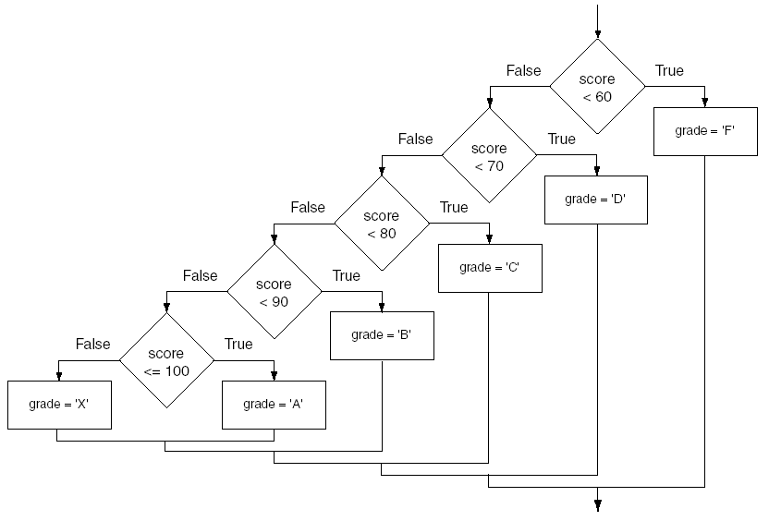
if-else-if Flowchart

Slide 25
if (score < 60) {
grade = “F”;
} else if (score < 70) {
grade = “D”;
} else if (score < 80) {
grade = “C”;
} else if (score < 90) {
grade = “B”;
} else if (score <= 100) {
grade = “A”;
} else {
// invalid score
}
if (score < 60) {
grade = “F”;
}
if (score < 70) {
grade = “D”;
}
if (score < 80) {
grade = “C”;
}
if (score < 90) {
grade = “B”;
}
if (score <= 100) {
grade = “A”;
} else {
\\ invalid score;
}
Do they produce the same results?
Even if they did, is there any advantage in using one over the other?

Slide 26
Coding Examples
AverageScore.java
ConsultantCharges.java
LoanQualifier.java
TestResults.java
StringCompare.java
StringCompareTo.java

Slide 27
Logical Operators

Slide 28
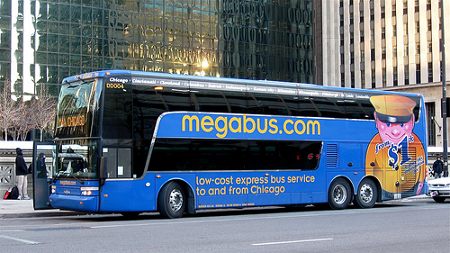
The AND Operator
AND

Slide 29
In what pair of conditions will Jenny will go to NY?
got paid | Megabus ticket is still available | Is Jenny going to NY?
true | false | false
false | true | false
false | false | false
true | true | true

Slide 30
OR

Slide 31
The OR Operator
Suzan is going with Jenny | Megabus ticket is still available | Is Jenny going to NY?
true | false | true
false | true | true
false | false | false
true | true | true
See LogicalOr.java program

Slide 32
The NOT Operator
gotSick | !gotSick
true | false
false | true

Slide 33
Logical Operators
Operator | Meaning | Example
&& | AND | if (ticketIsAvailable && gotPaid)
|| | OR | if (SuzanIsGoing || ticketIsAvailable)
! | NOT | if (!gotSick)
LogicalAnd.java
LogicalOr.java

Slide 34
The switch Statement

Slide 35
The switch Statement
switch(Expression) {
case CaseExpression:
// place one or more statements here
break;
case CaseExpression:
// place one or more statements here
break;
// case statements may be repeated
//as many times as necessary
default:
// place one or more statements here
}

Slide 36
switch(weekDay) {
case monday:
case tuesday:
case wednesday:
case thursday:
case friday:
System.out.println(weekday + “ is a “ + working day! Get out of the bed now”);
break;
case saturday:
doGroceries();
cutGrass();
case sunday:
goToChurch();
stayTheRestOfTheDayHome();
break;
// case statements may be repeated
//as many times as necessary
default:
// holiday!!!! Go to the beach!!!
}

Slide 37
Switch Examples
NoBreaks.java
PetFood.java
SwitchDemo.java

Slide 38
Formatting the Output

Slide 39
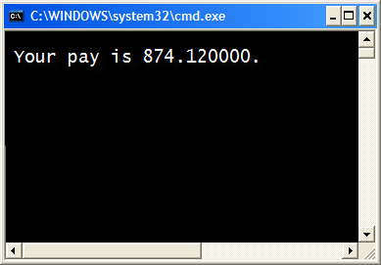
A common problem…
double grossPay = 874.12;
System.out.println("Your pay is “ + grossPay);

Slide 40
The DecimalFormat Class

Slide 41
Decimal Format
Format1.java
Format2.java
Format3.java
Format4.java

Slide 42
The printf method

Slide 43
The printf Method
double grossPay = 874.12;
System.out.println("Your pay is “ + grossPay);

Slide 44
The printf Method
System.out.printf(FormatString, ArgList);
FormatString is a string that contains text and/or special formatting specifiers.
ArgList is optional. It is a list of additional arguments that will be formatted according to the format specifiers listed in the format string.

Slide 45
The printf Method
double grossPay = 874.12;
System.out.printf("Your pay is %f.\n", grossPay);
The %f format specifier indicates that a floating-point value will be printed.
The contents of the grossPay variable will be printed in the location of the %f format specifier.

Slide 46
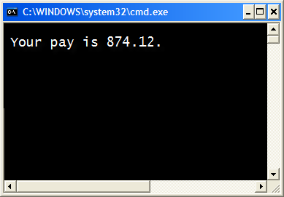
The printf Method
double grossPay = 874.12;
System.out.printf("Your pay is %.2f.\n", grossPay);
The %.2f format specifier indicates that a floating-point value will be printed, rounded to two decimal places.

Slide 47
The printf Method
int hours = 40;
System.out.printf("I worked %d hours.\n", hours);
The %d format specifier indicates that a decimal integer will be printed.
The contents of the hours variable will be printed in the location of the %d format specifier.

Slide 48
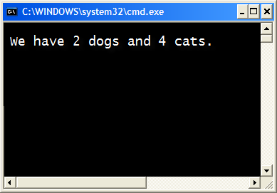
The printf Method
int dogs = 2, cats = 4;
System.out.printf("We have %d dogs and %d cats.\n",
dogs, cats);

Slide 49
The printf Method
String name = "Ringo";
System.out.printf("Your name is %s.\n", name);
The %s format specifier indicates that a string will be printed.

Slide 50
That’s the End of Chapter 3

Slide 51
Any Questions?

